Slide 1
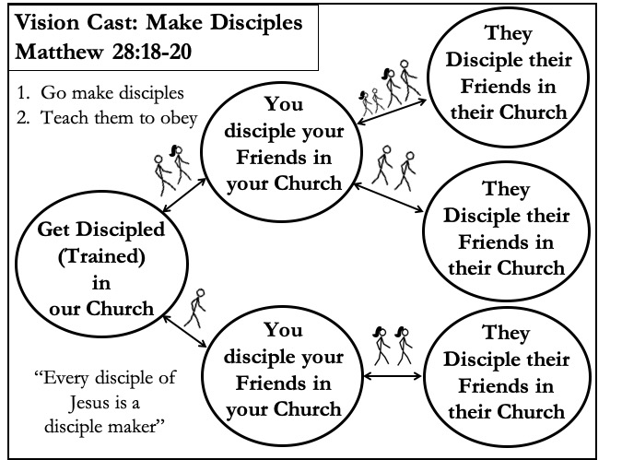
3/3RDS DISCIPLESHIP PROCESS
SHORT-TERM DISCIPLESHIP
Split time equally between thirds
1. Member Care
Ask everyone to share one high and low.
2. Loving Accountability
Ask everyone how their following and fishing
obedience to God went from last week.
3. Worship and Prayer
Worship Jesus through prayer, psalms, singing,
and/or taking the Lord’s Supper.
4. Vision Cast
Read Mt. 28:18-20. Ask the disciples if they are
willing to do those things. Explain how we make
disciples and teach to obey in churches.
5. New Scripture
Use the Sword method on the scripture passage.
6. Practice
Use the tools provided.
7. Responding to Holy Spirit
Ask the Holy Spirit what he wants you to do based
on the Holy Scripture and your interaction with the
Holy Church
Following:
Fishing:
1/3 – LOOK BACK
*Train new disciples on all these tools in the first week
COMMANDS | VISION CAST | SCRIPTURE | PRACTICE
1. Repent, Be Baptized + Receive the Holy Spirit | Make Disciples Mt. 28:18-20 | Acts 2:36-41 | Testimony* and Oikos*
2. Follow Jesus, Fish for People | Make Disciples Mt. 28:18-20 | Mk. 1:14-20 | B. Two Kingdoms*
3. Abide in Jesus | Make Disciples Mt. 28:18-20 | Jn. 15:1-11 | Say. Obey. Share*
4. Take Up Your Cross | Make Disciples Mt. 28:18-20 | Mk 8:27-38 | D. Counting the Cost*
5. Gather as a Church | Make Disciples Mt. 28:18-20 | Heb. 10:24-25 Acts 2:41-47 | E. Church Circle*
6. Seek First the Kingdom | Make Disciples Mt. 28:18-20 | Mt. 6:25-34 | F. Kingdom Priorities*
7. Love God and Obey | Make Disciples Mt. 28:18-20 | Mt. 22:37-40 Jn. 14:15-21 | G. Obey Survey + Vision Cast
2/3 – LOOK UP
What does this tell us about God?
What does this tell us about people?
Sin to avoid?
Promise to claim?
Example to follow?
Command to obey?
3/3 – LOOK AHEAD
For videos and more resources go to noplaceleftarmy.net

Slide 2
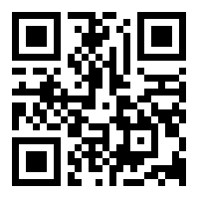
TOOLS TO PRACTICE
Train new disciples on all these tools in the first week
E. CHURCH CIRCLE
1) Find at least 10 of elements of healthy church elements in Acts 2:36-47:
A. TESTIMONY
There was a time in my life when I felt: _____________
After trusting Jesus as my King I feel: ____________
Evangelism (v41, 47)
Leaders (v42-43)
Baptism (v41)
Teaching (v42)
Fellowship (v42)
7
4
4
1
Prayer (v42)
Miracles (v43)
Giving (v45)
Praising God (v47)
Lord’s Supper (v46)
Have you ever trusted Jesus to be your King?
A. OIKOS
Write a list of 100 people you know.
Go share with someone right now.
2) Record the # of people in your church,
# of disciples of Jesus, # baptized, # your church has baptized. 3) Draw elements your church has done inside a dotted circle.
4) Ask everyone is this biblical church?
5) Ask everyone is this your church? If so, close the circle.
6) Name the church, write the leader’s name, and date it started.
Name, Leader, Date
B. TWO KINGDOMS
Which king are your serving?
C. SAY. OBEY. SHARE. (S.O.S.)
Read Matthew 6:9-15, then ask God…
S: What are You saying to me in this
passage?
O: How do You want me to obey this?
S: Who do You want me to share this
with?
F. KINGDOM PRIORITIES
1. LIST where you spend time & money. This reveals priorities.
D. COUNTING THE COST
I WOULD … STOP MAKING DISCIPLES
1. Definitely not
2. Possibly
3. Probably
4. Definitely
If I get invited to be a part of a church or ministry that does not challenge me to make disciples. [ ]
If I become socially ostracized by my friends. [ ]
If I am a part of a ministry that puts limits on making disciples. [ ]
If I am publicly caught in sin and disciplined. [ ]
If my spouse or significant other doesn’t want to make disciples. [ ]
If I am abandoned by my leader(s). [ ]
If my parents disapprove. [ ]
If there is unreconciled conflict. [ ]
If my financial security threatened. [ ]
If my employment is threatened. [ ]
If my education is threatened. [ ]
If I feel unqualified among my peers.[ ]
If I’m lonely. [ ]
If I become severely ill or become disabled. [ ]
If my current spiritual authority. [ ] forbids me from fully making disciples.
If my church tells me to stop. [ ]
If there is “Friendly fire” persecution from existing believers. [ ]
If there is a fear of false doctrine being spread. [ ]
If there is no fruit in “my” ministry while seeing fruit in others. [ ]
If it requires me to spend less time with family and friends. [ ]
Estimate the % chance you will stop
making disciples in 5 years.
--- % chance range [ 20% - 80% ] ---
Discuss how you can overcome your
greatest barriers to making disciples.
2. PRAY and ask Jesus if you are truly putting His Kingdom first.
3. SHARE with your church any areas that you need to change.
4. COMMIT to give time or resources as a church. Plan to take
an offering next week & immediately give it away.
G. OBEY SURVEY Give a Letter Grade. Together decide if you need to revisit any of the commands.
Command | Example | Personal Evaluation | Corporate Evaluation
1. Get Baptized | Be baptized personally Baptize new believers immediately
2. Follow and Fish | Share the Gospel via 2- Kingdoms Train Others to Share
3. Abide in Jesus | Read ~20 chapters per week Record SOS
4. Take Up Your Cross | Share with entire OIKOS list
5. Gather as Church | Meet regularly as a church Add missing elements to be healthier
6. Kingdom First | Re-prioritize time and money Giving as a church
Notes:
Add in Cross and Crown for Testimony.
Immediately Discipleship

Slide 3
Vision Cast: Make Disciples
Matthew 28:18-20
They
Disciple their
Friends in
their Church
1. Go make disciples
2. Teach them to obey
You
disciple your
Friends in
your Church
They
Disciple their
Friends in
their Church
Get Discipled
(Trained)
in
our Church
You
disciple your
Friends in
your Church
They
Disciple their
Friends in
their Church
“Every disciple of Jesus is a
disciple maker”

Slide 4
COMMANDS | VISION CAST | SCRIPTURE | PRACTICE
1. Repent, Be Baptized + Receive the Holy Spirit | Make Disciples Mt. 28:18-20 | Acts 2:36-41 | Testimony* and Oikos*
2. Follow Jesus, Fish for People | Make Disciples Mt. 28:18-20 | Mk. 1:14-20 | B. Two Kingdoms*
3. Abide in Jesus | Make Disciples Mt. 28:18-20 | Jn. 15:1-11 | Say. Obey. Share*
4. Take Up Your Cross | Make Disciples Mt. 28:18-20 | Mk 8:27-38 | D. Counting the Cost*
5. Gather as a Church | Make Disciples Mt. 28:18-20 | Heb. 10:24-25 Acts 2:41-47 | E. Church Circle*
6. Seek First the Kingdom | Make Disciples Mt. 28:18-20 | Mt. 6:25-34 | F. Kingdom Priorities*
7. Love God and Obey | Make Disciples Mt. 28:18-20 | Mt. 22:37-40 Jn. 14:15-21 | G. Obey Survey + Vision Cast
What does this tell us about God?
What does this tell us about people?
Sin to avoid?
Promise to claim?
Example to follow?
Command to obey?

Slide 5
C. SAY. OBEY. SHARE. (S.O.S.)
Read Matthew 6:9-15, then ask God…
S: What are You saying to me in this
passage?
O: How do You want me to obey this?
S: Who do You want me to share this
with?
D. COUNTING THE COST
I WOULD … STOP MAKING DISCIPLES
1. Definitely not
2. Possibly
3. Probably
4. Definitely
If I get invited to be a part of a church or ministry that does not challenge me to make disciples. [ ]
If I become socially ostracized by my friends. [ ]
If I am a part of a ministry that puts limits on making disciples. [ ]
If I am publicly caught in sin and disciplined. [ ]
If my spouse or significant other doesn’t want to make disciples. [ ]
If I am abandoned by my leader(s). [ ]
If my parents disapprove. [ ]
If there is unreconciled conflict. [ ]
If my financial security threatened. [ ]
If my employment is threatened. [ ]
If my education is threatened. [ ]
If I feel unqualified among my peers.[ ]
If I’m lonely. [ ]
If I become severely ill or become disabled. [ ]
If my current spiritual authority. [ ] forbids me from fully making disciples.
If my church tells me to stop. [ ]
If there is “Friendly fire” persecution from existing believers. [ ]
If there is a fear of false doctrine being spread. [ ]
If there is no fruit in “my” ministry while seeing fruit in others. [ ]
If it requires me to spend less time with family and friends. [ ]
Estimate the % chance you will stop
making disciples in 5 years.
--- % chance range [ 20% - 80% ] ---
Discuss how you can overcome your
greatest barriers to making disciples.

Slide 6
E. CHURCH CIRCLE
F. KINGDOM PRIORITIES
1. LIST where you spend time & money. This reveals priorities.
Evangelism (v41, 47)
Leaders (v42-43)
Baptism (v41)
Teaching (v42)
Fellowship (v42)
7
4
4
1
2. PRAY and ask Jesus if you are truly putting His Kingdom first.
Prayer (v42)
Miracles (v43)
Giving (v45)
Praising God (v47)
Lord’s Supper (v46)
3. SHARE with your church any areas that you need to change.
4. COMMIT to give time or resources as a church. Plan to take
an offering next week & immediately give it away.
2) Record the # of people in your church,
# of disciples of Jesus, # baptized, # your church has baptized. 3) Draw elements your church has done inside a dotted circle.
4) Ask everyone is this biblical church?
5) Ask everyone is this your church? If so, close the circle.
6) Name the church, write the leader’s name, and date it started.
Name, Leader, Date
G. OBEY SURVEY Give a Letter Grade. Together decide if you need to revisit any of the commands.
Command | Example | Personal Evaluation | Corporate Evaluation
1. Get Baptized | Be baptized personally Baptize new believers immediately
2. Follow and Fish | Share the Gospel via 2- Kingdoms Train Others to Share
3. Abide in Jesus | Read ~20 chapters per week Record SOS
4. Take Up Your Cross | Share with entire OIKOS list
5. Gather as Church | Meet regularly as a church Add missing elements to be healthier
6. Kingdom First | Re-prioritize time and money Giving as a church

