Slide 1
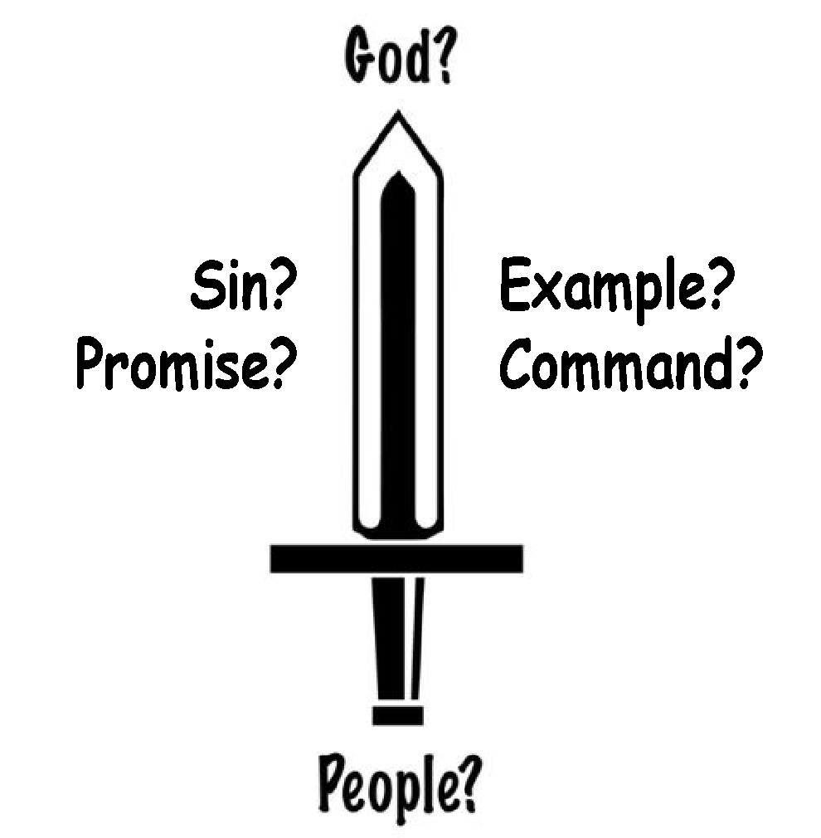
MIDTERM DISCIPLESHIP PLAN
LESSON | PASSAGE | SCRIPTURE TO MEMORIZE | PRACTICE
1. Rooted in Scripture | John 1:1-18 | John 1:14 | Cornerstone
2. Own Your Oikos | John 1:29-51 | Acts 1:8 | 100 Person Oikos / Red-Yellow-Green Lights
3. Share our Identity | Mark 5:1-20 | Mark 1:15 | MAWL Testimony
4. Share the Gospel of the Kingdom | Matthew 9:35-10:8 | Matthew 9:37-38 | MAWL Two Kingdoms
5. Identify the Faithful | John 17 | 2 Timothy 2:2 | 1-3-9 / Downstream A-Team
6. Rely on God | Matthew 6:5-16 | Matthew 6:9-13 | Prayer Wheel
7. Humbly receive & apply feedback from the Church | Matthew 25:14-30 | John 14:21 | Iron on Iron
8. Meditate on the Word | Matthew 4:1-11 | Matthew 4:4 | Mid-Term Discipleship Scripture Memory
9. Embrace your Identity | 2 Cor 5:14-6:1 | Galatians 2:20 | New Creation Illustration
10. Forgive as God forgives | Matthew 18:21-36 | Matthew 6:14-15 | Lord’s Supper / Relationship Inventory
11. A Vision for Generations | 2 Timothy 1:13-2:7 | Matthew 28:18-20 | MAWL Multiplication Strategy: Ask your leader to watch your 3/3 church
12. Prioritize Christ centered Church | Mark 3:13-35 | John 13:34-35 | 6 Hour Guideline
13. Be Faithful | Luke 12:35-48 |  | Obey Survey
TRAINING TO MASTERY
Mastery (Luke 6:40): when one disciple can train other disciples to reproduce a simple tool, articulate the Scriptural principle behind that tool, and evaluate the tool being reproduced in churches and networks.
1. Member Care
2. Loving Accountability
3. Worship and Prayer
4. Vision Cast
5. New Scripture
Head: SWORD
Heart: How does this passage
make you feel?
Hands: Practice
6. Practice
7. Obedience to Holy Spirit
1/3
2/3
3/3
Sower
TOOLS FOR PRACTICE
Parable
1
2
3
4
1 - CORNERSTONE
Based upon your capacity, develop a plan for reading the entire bible, while keeping your eyes fixed on Jesus in the gospels. we recommend splitting up your time in the Word as follows:
Meaning
These lessons are designed to help you train your
Chapters per day | Old Testament | Gospels | New Testament
1 |  | 1
3 | 1 | 1 | 1
5 | 3 | 1 | 1
OLD
TESTAMENT
NEW
TESTAMENT
JESUS
Note: 5 chapters will take you through the entire bible in a year
Notes:
- Add 1-3-9 Explanation
- Write your own Obey Survey

Slide 2
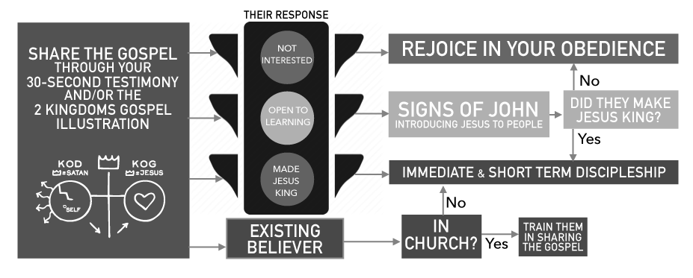
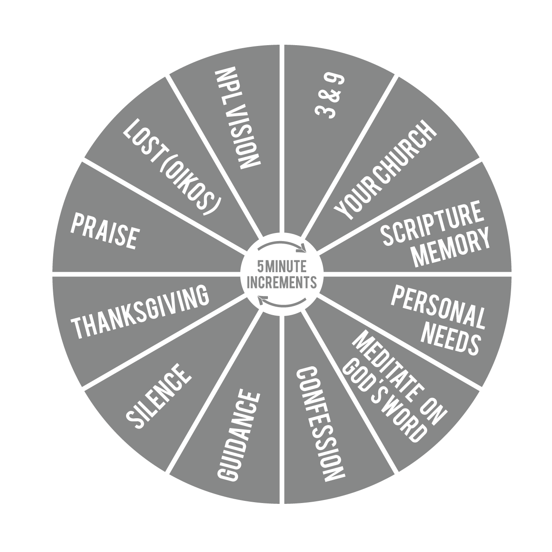
TOOLS FOR PRACTICE (cont.)
2a - TOP 100 OIKOS
4 - MAWL TWO KINGDOMS
Go to www.noplaceleftarmy.net and download the A-Team card from the Lessons and Resources page. Fill in your top 100 Oikos on that card
Practice the Two Kingdoms just like you did with your testimony last week. Set a time to MAWL with a leader.
5 - 1-3-9
2b - RED YELLOW, GREEN LIGHTS
Just as Jesus had three that He spent the most time with, also identify your three most faithful people.
1. ______________ 2. ______________ 3. ______________
Who are the 3 God has entrusted to them?
1. ______________ 1. ______________ 1. ______________
2. ______________ 2. ______________ 2. ______________
3. ______________ 3. ______________ 3. ______________
For the full flow chart, find it on the Lessons & Resources page at www.noplaceleftarmy.net
5 - A-TEAM
Print off the A-team card at noplaceleftarmy.net
Review the A-team card as a church
Identify an emerging leader within your church and get an A-team with that person this week.
3a - MAWL
6 – PRAYER WHEEL
Watching a clock or using a timer, find a quiet place to pray individually for an hour, using this prayer wheel.
MAWL is an acronym for teaching new skills/tools. This flow optimizes learning and confidence:
Stage | Teacher | Student
Model | Do | Watch
Assist | Help | Do
Watch | Watch | Do
Launch |  | Do
START HERE
3b - MAWL TESTIMONY
Partner up and share your testimony with one another. Allow the other person to answer and practice responding to their answer. Switch roles. Once both partner have had a turn, rotate partners.
Set a time with a leader in your church to meet and MAWL sharing your testimony
Notes:
Prayer wheel-
Praise, Lost (oikos), NPL Vision, 1-3-9, Church, Review SM, Personal Needs, Meditate on the Word, Confession, Guidance, Silence, Thanksgiving

Slide 3
TOOLS FOR PRACTICE (cont.)
7 - BASIC IRON ON IRON
9 - NEW CREATION ILLUSTRATION
Read 2 Cor 5:14-21. Draw the table below, leaving everything blank but the acronym REALM. Ask the following questions (fill in the table): Can a caterpillar reproduce? What does it eat? What action does it do? What does it look like? How does it move?
Now filling in the butterfly column, ask the same questions: Does a butterfly reproduce? What does it eat? etc…
Then ask: What happens if the butterfly still thinks it’s a caterpillar? What will it do? What happens if a disciple still thinks they are the old person? What will they do?
Repeat the questions one more time, this time about our Identity as New Creations
An Iron on Iron (IoI) is a diagnostic tool for coaching church leaders in effectively overseeing the men and women under their care (Prov. 27:23). The IoI, which should take no more than 1 hour, is facilitated by an””’’ overseer and with members of the body of Christ present for input (Eph. 4:11-13). Always remember, the goal is not to INFLATE or make feel INFERIOR, but to INSTRUCT and INSPIRE.
Prayer
Did you obey what God told you last time?
How much Scripture are you consuming daily?
What has God spoken to you through His Word?
How much time are you spending in prayer daily?
What prayers are you seeing answered?
How many times a week are you sharing the gospel?
How are your 1-3-9 doing?
Talk through Gen Map
What are you most excited about?
Where do you feel stuck?
Encouragement from church
Feedback from church
Write down and share your action plan, based on what you are
hearing from the Holy Spirit
R EPRODUCE
E AT
A CTION
L OOK LIKE
M OVE
NO
LEAVES
DESTROY
UGLY
CRAWL
YES
NECTAR
GIVES LIFE
PRETTY
FLY
DISCIPLE MAKERS (Mt 28:18-20)
WORD OF GOD (1 Peter 2:2)
SERVANT (John 15:20)
CHILD OF GOD (John 1:12)
HOLY SPIRIT (Gal 5:25)
8 – MID-TERM DISCIPLESHIP SCRIPTURE MEMORY
Memorize Matt 28:18-20 as a church, and recite until everyone can quote it without help.
Download RememberMe app. Go to www.remem.me and search NPL Army. Download the No Place Left Army Mid Term Discipleship pack and begin memorizing
When you’ve memorized a verse, move it to the “Due” category.
Every day, select the Due category and press the dark flashcards to test your memorization skills.
Continue memorizing new verses and reciting the “Due” daily.
Are you living out your NEW IDENTITY in Christ, as a new creation? Are you living like you are born again? Do you see yourself as God sees you? Are you making disciples, feeding on the Word of God...etc?
10a - LORD’S SUPPER
(Ensure you plan ahead to have bread and juice ready)
Pray then Read 1 Cor 11:23-32
Ask the question: “What does this tell us about Communion?”
Pass out bread/cracker & juice/wine
Read 1 Cor 11:24 -break and eat bread
Read 1 Cor 11:25- drink juice and close in prayer

Slide 4
TOOLS FOR PRACTICE (cont.)
10b- RELATIONSHIP INVENTORY
13- OBEY SURVEY
Take inventory of all your relationships and ask yourself “Who do I need to forgive?” Write down their names and make a list what you need to do to make amends this week.
Now ask, “Who do I need to ask for forgiveness?” Make another list of names and what you need to do to make amends.
Make your own Midterm Obey Survey. Have your church evaluate themselves on the Short and Midterm Lessons and make a plan for the way ahead.
A couple examples are provided below:
Mid-Term Obey Survey
Lesson | Examples to Follow | Corporate Evaluation | Individual Evaluation
1. Rooted In Scripture | In Scripture everyday and focusing on Jesus as the Center
2. Own your Oikos | Sharing with the 100 names on your oikos list and able to categorize their responses
11 - MAWL MULTIPLICATION STRATEGY
Partner up and pull out your Short Term Discipleship sheet. Practice the Multiplication strategy and drawing as you share (if possible).
Give Feedback to one another. After each person has shared with their partner rotate. Try to get at least 3 repetitions in.
Schedule a time for your overseer to come and MAWL your church. If possible, try to get 2 levels up to Watch while your overseer Assists.
12 - THE 6-HOUR GUIDELINE
For a video explaining the 6-hour guideline, visit the Lessons & Resources page on www.noplaceleftarmy.net
1 Hour A Team
1 Hour A Team
Your
Friend’s
Church
Your
Church
Our Church
2 hours training others in your church
2 hours training in a church weekly
2 Hours Getting Trained in Church 2 Hours Training Others in Church 1 Hour Getting Developed as a Leader 1 Hour Developing Leaders
6 Total Hours

